Slide 1

Real-time Bus Transit Analysis Based on Meteorology & Traffic
Group 8 Super Wings
Yao Jingxuan A0261830L
Meng Jiang A0285681R
Shen Jiajing A0285773M
Zhang Zhan A0285997X
Zeng Fanyi A0285753R

Slide 2
Contents
Business Understanding
1
2
Structure
Data Source
3
4
Data Ingestion
5
Modelling
6
Pipeline Building
7
Conclusion

Slide 3

Business Understanding

Slide 4

Business Understanding
Stakeholder : The Land Transport Authority (LTA) & Passengers
Business Problem
Nowadays, public transportation is playing a crucial role in urban environments. However, challenges such as weather and varying passenger loads often affect the punctuality and reliability of bus services. We aim to provide a more accurate method for predicting travel time between bus stations.
Our Goal
Predict station-to-station intervals using passenger flow, rainfall, distance, and date.
For LTA: Help to optimize bus schedules and offer higher-quality services.
Help to monitor the operation of bus systems and provide data support for decision-making.
For passenger: Provide a platform to input departure and destination stops to estimate bus travel time.
Improve their travel experience.

Slide 5
Structure

Slide 6
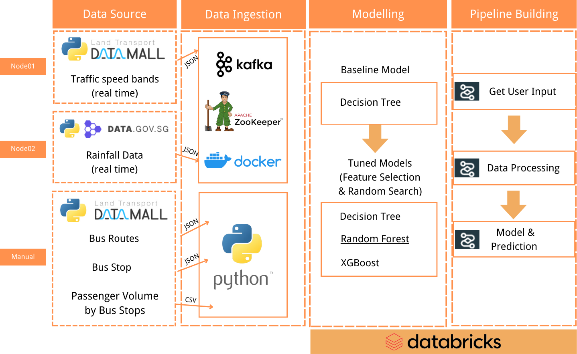
Structure

Slide 7
Data Source

Slide 8
Data Source — Data Dictionary for Real Time Data
Traffic speed bands : Current traffic speeds on expressways and arterial roads, expressed in speed bands.
Attributes | Description | Sample
LinkID | Unique ID for this stretch of road | 103046935
SpeedBand | Speed Bands Information. Total: 8 1 – indicates speed range from 0 < 9 ... 8 – speed range from 70 or more | 2
StartLon | Longitude map coordinates for start point for this stretch of road. | 103.86246461405193
StartLat | Latitude map coordinates for start point for this stretch of road. | 1.3220591510051254
EndLon | Longitude map coordinates for end point for this stretch of road. | 103.86315591911669
EndLat | Latitude map coordinates for end point for this stretch of road. | 1.3215993547809128
Rainfall：Precipitation readings at weather-station level, updated every five minutes.
id | Id of the monitoring area | S77
location | Location of the monitoring area | "latitude": 1.2937, "longitude": 103.8125
timestamp | timestamp | 2024-01-27T14:35:00+08:00
value | 0 - no rainfall ： > 0 - rainy | 0

Slide 9
Data Source — Data Dictionary for Local Data
Bus Routes : Detailed route information for all services currently in operation.
Attributes | Description | Sample
ServiceNo | The bus service number | 10
Direction | Distance travelled by bus from starting location to this bus stop (in kilometres) | 1
StopSequence | The i-th bus stop for this route | 28
BusStopCode | The unique 5-digit identifier for this physical bus stop | 01219
Distance | Distance travelled by bus from starting location to this bus stop (in kilometres) | 10.3
Bus Stop : Detailed information for all bus stops currently being serviced by buses.
BusStopCode | The unique 5-digit identifier for this physical bus stop | 01219
Latitude | Location coordinates for this bus stop | 1,29
Longitude | Location coordinates for this bus stop | 103.85
Passenger Volume by Bus Stops : Tap in and tap out passenger volume by weekdays and weekends for individual bus stop.
DAY_TYPE PT_CODE | The unique 5-digit identifier for this physical bus stop | 01219
DAY_TYPE | Two value: WEEKDAY ; WEEKENDS/HOLIDAY | WEEKDAY
TIME_PER_HOUR | 24h in a day from 0 to 23 | 20
TOTAL_TAP_IN_VOLUME | Passenger volume tap in bus | 853
TOTAL_TAP_OUT_VOLUME | Passenger volume tap out bus | 834

Slide 10
Data Integration

Slide 11
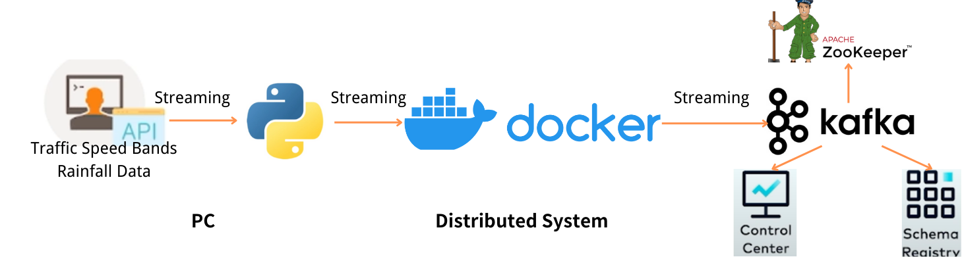
Data Integration - Realtime Data
1
API Connector
2
Docker Container Building
3
Kafka Streaming
(1) Read real-time data
Traffic Speed Bands
Rainfall
(2) Connect with Docker
From PC to Distributed System
(1) ZooKeeper
(2) Schema-registry
(3) Kafka Broker
(4) Control-center
(1) Kafka Producer
(2) Kafka Topics
(3) Download records
for local model training

Slide 12
Data Integration - ETL
1
Extract
Realtime data
RainfallValue, SpeedBand
Getting hourly data from API using Kafka
From Mar 30th to Apr 05th
Local data
PassengerVolume, BusStop, BusRoutes
Getting data from API using Python
From Mar 30th to Apr 05th
Select Route 10, operating from 6 a.m. to 12 a.m.
2
Transform
Merge Data & Table
Rainfall station and value
Speed band
Bus info, bus routes
and passenger volume
Calculate Data
Speed, Latitude, Longitude
Bus stop interval distance
Bus stop interval
Data Encode
Day type
Time per hour
Clean Data
Drop missing value
3
Load
Load Data into Python
Pandas
Integrate into one table
"merged_data"
Divide Dataset
70% for training
30% for testing

Slide 13
Modelling

Slide 14
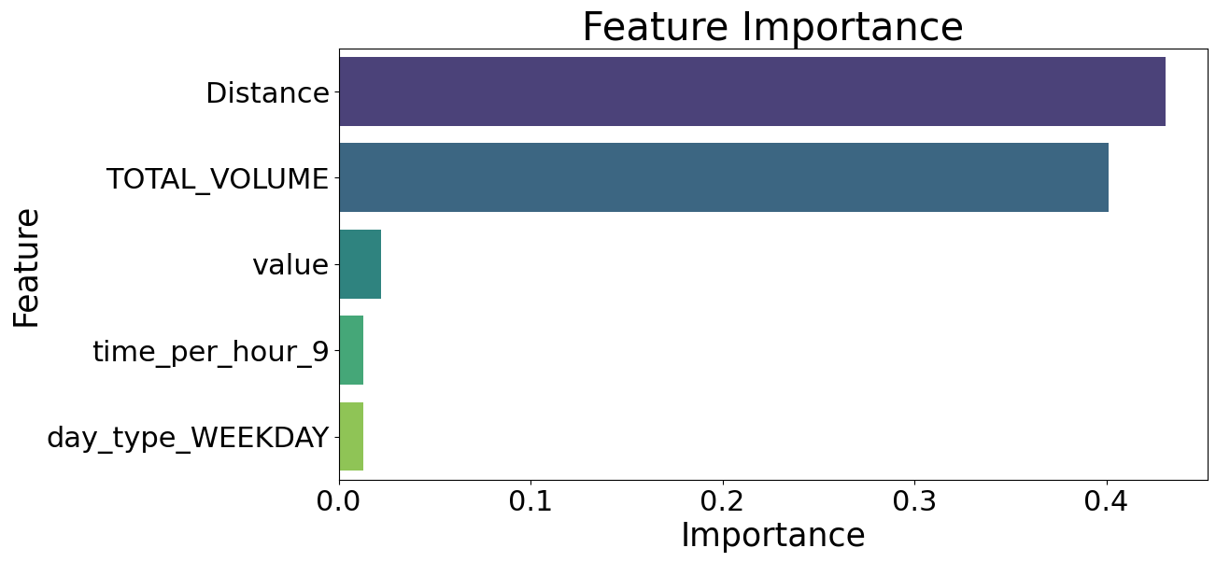
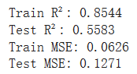
Modelling – Tree Model
0
Real-time data:
from 6 am on March 30 to 12am on April 6
Local data:
extracted in March
2
Feature Selection
1
Baseline Model: Decision Tree
No feature selection
& Parameter Settings
X: Distance, TOTAL_VOLUME, value
y: Interval for the next hour
3
Model Enhancement
4
Export to a joblib File
(1) Build bagging-random forest
& boosting-xgboost
(2) Realize adaptability
- Use grid search to determine suitable
parameter ranges
- Use random search to find best parameters
(3) Compare the results
Random Forest model:
Best parameters for Random Forest:
{'max_depth': 21, 'min_samples_leaf': 2, 'min_samples_split': 2, 'n_estimators': 67}

Slide 15
Modelling – Result Comparison
Tree Model Comparison |  | Baseline Model | Models with Best Parameters
 |  | Decision Tree | Decision Tree | Random Forest | XGBoost
R-squared | Train set | 0.854 | 0.787 | 0.750 | 0.551
 | Test set | 0.558 | 0.572 | 0.614 | 0.541
MSE | Train set | 0.063 | 0.191 | 0.107 | 0.193
 | Test set | 0.127 | 0.123 | 0.111 | 0.132
Random Forest performed best:
Minimized MSE (0.111), maximized R-squared (0.614)
Robust to noise and outliers - suitable for datasets with moderate dimensions (19,418 rows, 4 columns)
Best parameters for Random Forest:
{'max_depth': 21, 'min_samples_leaf': 2, 'min_samples_split': 2, 'n_estimators': 67}

Slide 16
Pipeline Building

Slide 17
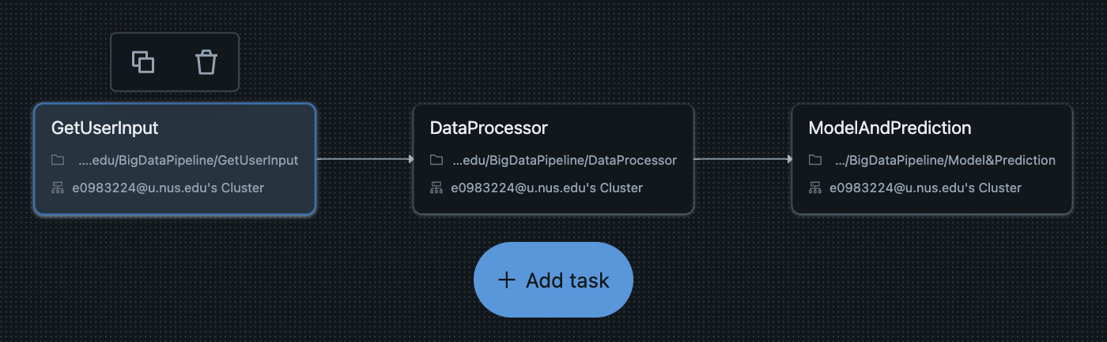
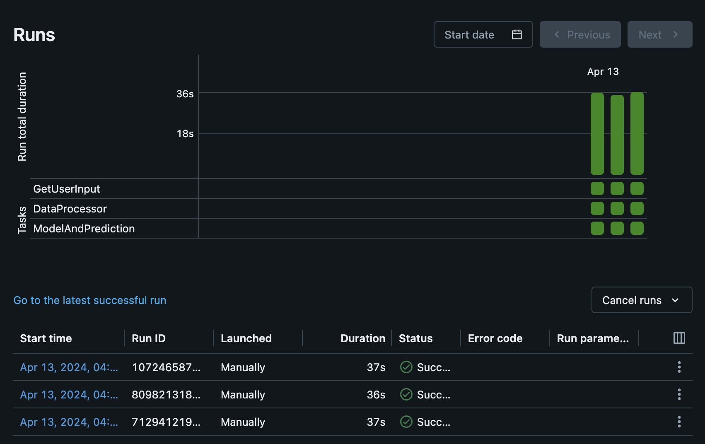
Platform Selection
– Reasons for Choosing Azure Databricks
1
Unified and collaborative environment for data jobs
3
Clear and user-friendly workflow deployment and monitoring
support multiple tasks
offer multi-language development capability
can share files and compute resources
2
Cloud service capability
compatible with various public cloud providers
chose Azure Databricks
Databricks – 14 days free tier
Azure Databricks - $100 start credit for students
4
Previous experience

Slide 18



Workflow Design
Details of DataProcessor
GetUserInput
Get user input
Get query time
Merge 3 tables to get a master table for prediction
Match the related records based on the 'weekday', 'hour' of query and inputted 'start_code', 'end_code', return the records which indexes between 'start_code' and 'end_code'
Get independent variables (feature1 to 3) from related records
Start_code, end_code,
Current_time, weekday
filtered_mergered_data.csv
Column | Function
day_type | joint primary key
time_per_hour
code_x
Distance_x | feature1
TOTAL_VOLUME | feature2
station_id | match column
DataProcessor
Get real-time data and static data
Match real-time data and static data according to user query
Generate the Xs for the prediction
3 Tasks
distance_ls,
total_volume_ls,rainfall_value_ls
ModelAndPrediction
Get Xs
Call the trained model to predict
Get prediction result
bus_info.csv
Column | Function
StopSequence | positioning records for prediction
BusStopCode_X | match column
rainfall.csv
Column | Function
id | match column
reading_value | feature3

Slide 19

Demo Video

Slide 20

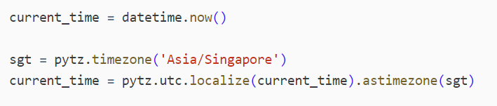
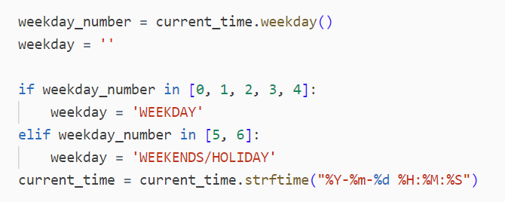
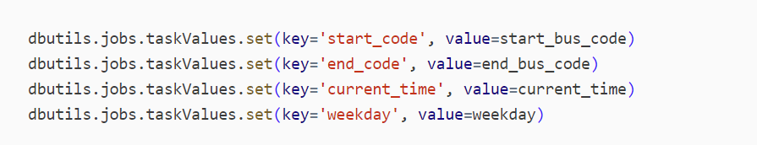
Dive Into the Workflow —— Get User Input
TXT File User Input: Start Bus Stop Code, End Bus Stop Code
Get Current Time:
Transform data into required format:
Set task values to be passed to next task

Slide 21
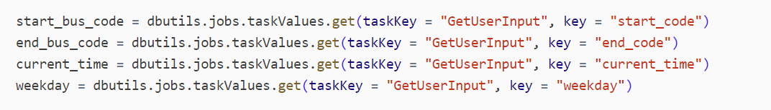
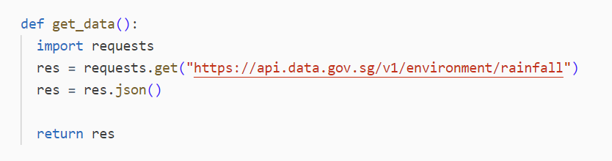
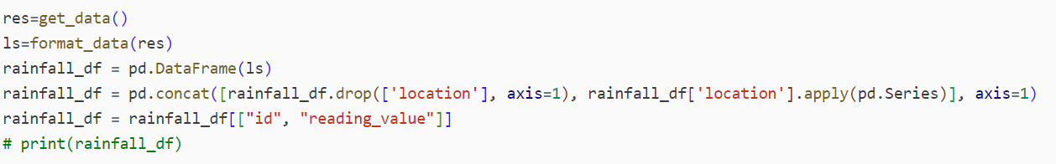
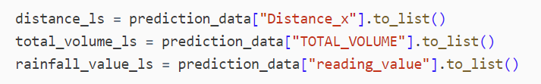
Dive Into the Workflow —— Data Processor
Get task value from the 1st task:
Use API to access real-time rainfall data:
Transform data into required format:
Create 3 variables to be used as model inputs: distance_ls, total_volume_ls, rainfall_value_ls

Slide 22
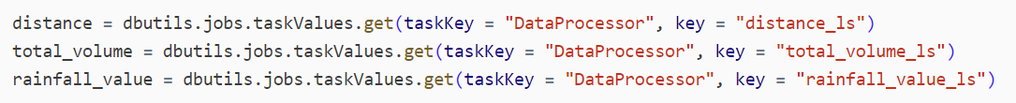
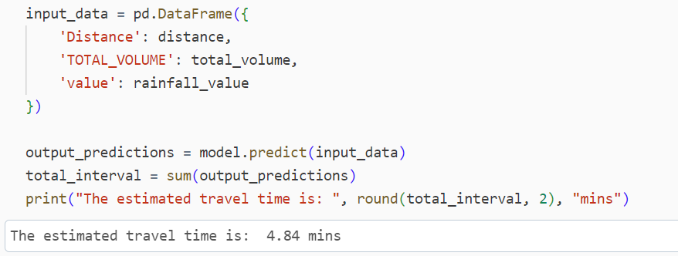
Dive Into the Workflow —— Model & Prediction
Get task value from the 2st task:
Load the trained model:
Input 3 variables into the trained model, obtain the prediction result, and output the result:

Slide 23


Conclusion
Success Factor
Model's Comprehensiveness
Rainfall value and the patterns of traffic volume
Real-time Factor
API — real-time rainfall data
Integrity of the workflow
User input retrieval — data processing — model invocation
However...
Time and Budget constraints
Bus Route 10 & Model cannot be updated automatically
Speed Band Data Retrieval Constraint
Unable to directly access the historical data

Slide 24
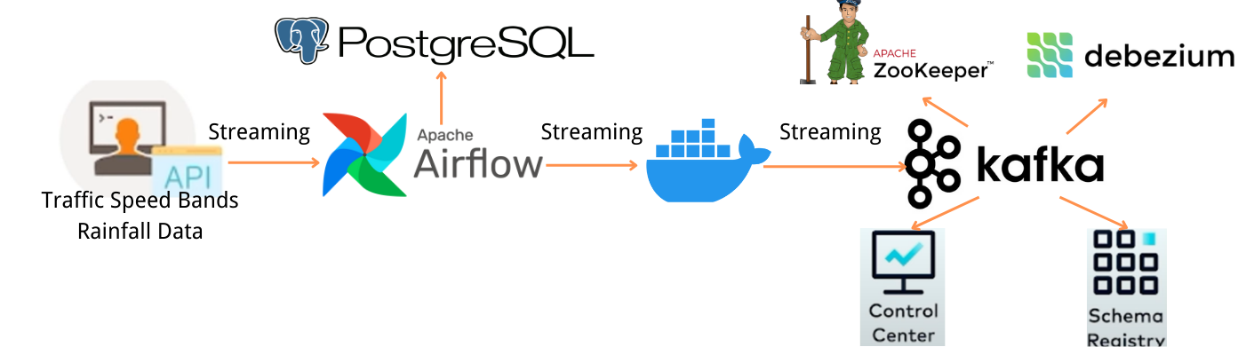
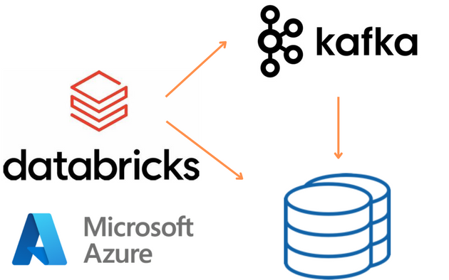
Additional Effort - Realtime Data
1
Local Environment
2
Cloud Environment
Postgres Database in Docker / PC
Using Airflow to connect Kafka and Database
Time limitation
Not suitable for teamwork
Databricks, Azure and Kafka
Insufficient cluster quota in trial version
Budgetary constraints: unable to create
Kafka and database sources in Azure

Slide 25

Thanks for Listening!
Group 8 Super Wings
Yao Jingxuan A0261830L
Meng Jiang A0285681R
Shen Jiajing A0285773M
Zhang Zhan A0285997X
Zeng Fanyi A0285753R

